Slide 1

KUZA CAPITAL FINANCE
ALL IN ONE NEW SYSTEM
PROCESS FLOWS
Date: March 02, 2026

Slide 2
KUZA BIASHARA PRODUCTS
KUZA BODA
KUZA SOKONI
KUZA WAFANYAKAZI (SPECIAL GROUP)
KUZA SIMU
OTHERS....

Slide 3
OVERVIEW OF KUZA BODA SYSTEM
Product Description: KuzaBoda provides assets financing for motorcycle (boda boda) riders, focusing on tires/stock via 30-day loans; targets youth and undeserved communities.
Stakeholders: Boda Riders, One Stop Sales Point Leaders, District/Ward Leaders, Field Operations, Finance Team, Tech Team, Directors, Store Keepers.
AS IS
TO BE
Semi-manual processes with USSD, physical verifications, forms; prone to delays, errors.
Automated system with USSD/App/Web access, integrations (MNOs, ERP), role-based controls; improves efficiency, compliance.

Slide 4
KUZA BODA ( AS IS VS TO BE)
PROCESS | AS-IS (CHALLENGES) | TO-BE (IMPROVEMENTS)
KYC | MANUAL FORMS, PHYSICAL SUBMISSION; ERRORS. | DIGITAL CAPTURE/STORAGE; AUTOMATED CHECKS.
VERIFICATION | PHYSICAL VISITS, MANUAL REVIEWS. | WORKFLOW AUTOMATION, MAKER-CHECKER APPROVALS.
LOAN APPLICATION | MANUAL FORMS | SELF-SERVICE USSD/APP; INSTANT CHECKS.
CREDIT SCORING | NO CREDIT SCORE. | AUTOMATED USING KYC DATA; INTEGRATED ASSESSMENT.
PENALTY CALCULATION | LIKELY MANUAL; NOT DETAILED. | AUTOMATIC CALCULATION FOR OVERDUES; REAL-TIME UPDATES.

Slide 5
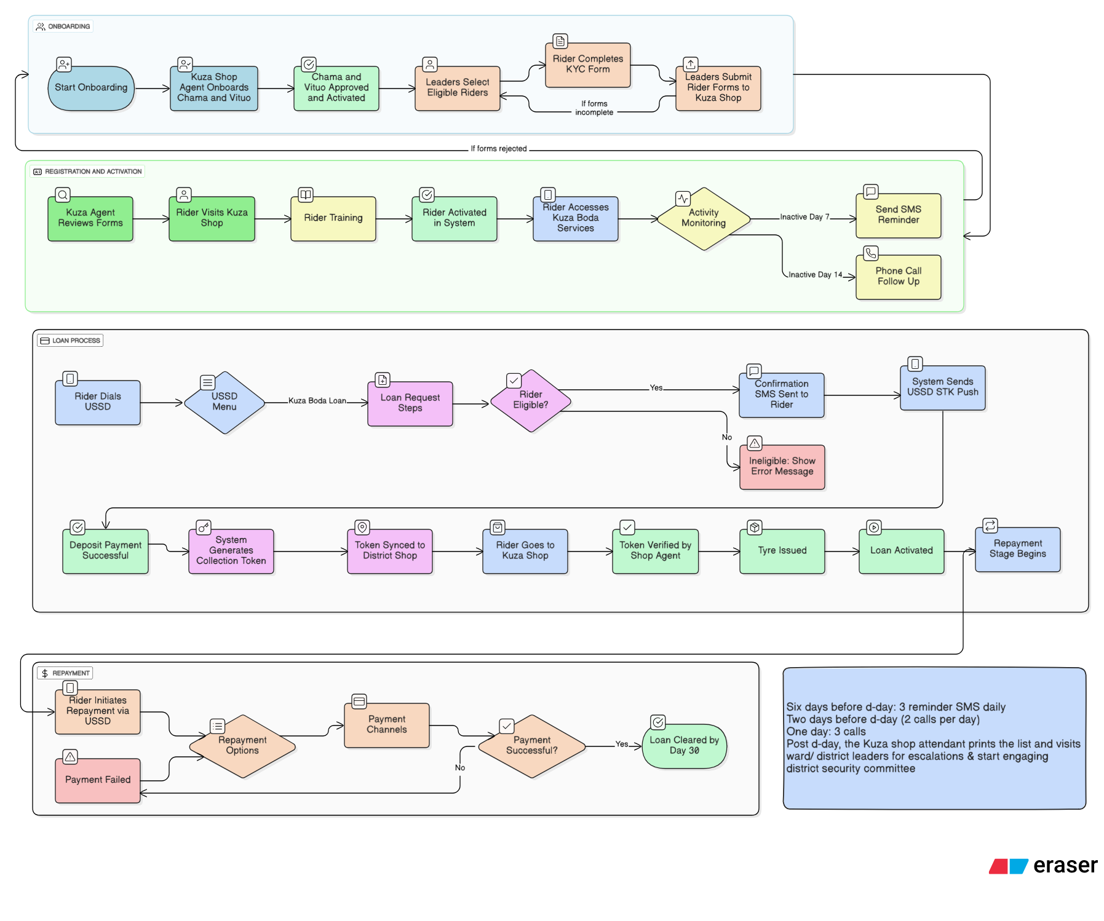

Slide 6
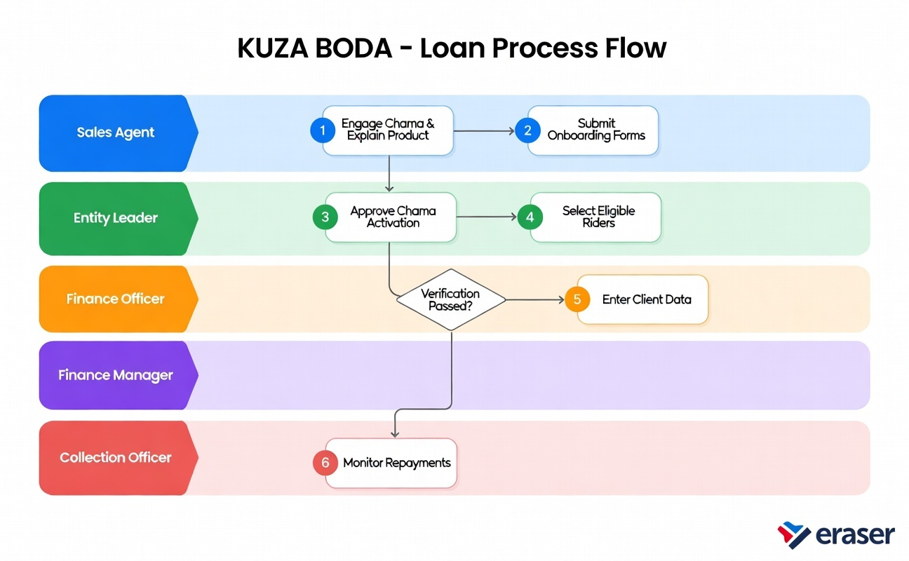

Slide 7
A.ONBOARDING PROCESS
On-boarding
Registration & activation process
Loan request & disbursement process
Repayment process
Collection & escalation process
STEP NO | ROLE | PROCESS DESCRIPTION
1 | One Stop Shop Agent | Start onboarding process
2 | One Stop Shop Agent | Onboard Chama/Vituo into the Kuza system
3 | Kuza System / HQ | Approve and activate Chama and Vituo
4 | Chama / Vituo Leaders | Select eligible boda riders
5 | Boda Rider | Complete KYC form
6 | Chama / Vituo Leaders | Submit completed rider forms to Kuza Shop
7 | Kuza Shop Agent | Return forms for correction if incomplete or rejected

Slide 8
B.REGISTRATION & ACTIVATION PROCESS
On-boarding
Registration & activation process
Loan request & disbursement process
Repayment process
Collection & escalation process
STEP NO | ROLE | PROCESS DESCRIPTION
8 | Kuza Agent | Review rider KYC and onboarding forms
9 | Boda Rider | Visit Kuza Shop for physical verification
10 | Kuza Agent | Conduct rider training (loan request & repayment)
11 | Kuza System | Activate rider in the system
12 | Boda Rider | Access Kuza Boda services
13 | Kuza System | Monitor rider activity
14 | Kuza System | Send SMS reminder after 7 days of inactivity
15 | Kuza Shop Agent | Make phone call follow-up after 14 days of inactivity

Slide 9
C. LOAN REQUEST & DISBURSEMENT
On-boarding
Registration & Activation
Loan request & Disbursement
Repayment process
Collection & escalation process
STEP NO | ROLE | PROCESS DESCRIPTION
16 | Boda Rider | Dial USSD
17 | Kuza System | Display USSD menu
18 | Boda Rider | Select Kuza Boda Loan option
19 | Kuza System | Guide rider through loan request steps
20 | Kuza System | Check rider eligibility
21 | Kuza System | Display error message if rider is ineligible
22 | Kuza System | Send confirmation SMS if eligible
23 | Kuza System | Send USSD STK push

Slide 10
C. LOAN REQUEST & DISBURSEMENT
On-boarding
Registration & Activation
Loan request & Disbursement
Repayment process
Collection & escalation process
STEP NO | ROLE | PROCESS DESCRIPTION
24 | Boda Rider | Make deposit payment
25 | Kuza System | Confirm deposit payment successful
26 | Kuza System | Generate collection token
27 | Kuza System | Sync token to district / Kuza shop
28 | Boda Rider | Visit Kuza shop
29 | Kuza Shop Agent | Verify collection token
30 | Store Keeper / Kuza Shop | Issue tyre to rider
31 | Kuza System | Activate loan
32 | Kuza System | Begin repayment stage

Slide 11
D. REPAYMENT PROCESS
On-boarding
Registration & Activation
Loan request & Disbursement
Repayment process
Collection & escalation process
STEP NO | ROLE | PROCESS DESCRIPTION
33 | Boda Rider | Initiate repayment via USSD
34 | Kuza System | Display repayment options
35 | Boda Rider | Select payment channel
36 | MNO / Payment Gateway | Process payment
37 | Kuza System | Mark payment as failed if unsuccessful
38 | Kuza System | Update loan balance if payment successful
39 | Kuza System | Clear loan on Day 30 if fully paid

Slide 12
E.COLLECTION & ESCALATION
On-boarding
Registration & Activation
Loan request & Disbursement
Repayment process
Collection & Escalation
STEP NO | ROLE | PROCESS DESCRIPTION
40 | Kuza System | Send daily SMS reminders (6 days before due date)
41 | Kuza System | Trigger phone calls (2 days before due date)
42 | Kuza System | Flag loan as overdue on due date
43 | Kuza Shop Attendant | Print overdue loan list
44 | Kuza Shop Attendant | Visit ward/district leaders
45 | District/Ward Leaders | Engage rider for repayment
46 | Security Committee | Support recovery for defaulted loans

Slide 13
OVERVIEW OF KUZA SOKONI SYSTEM
Product Description: Kuzasokoni provides
●​ Dynamic creation and ongoing management of financial products within the system
●​ Configuration of product-specific charges, fees, interest rates, penalties, and pricing rules
●​ Configuration of product-specific KYC and customer verification requirements
●​ Management of system users, roles, permissions, and access assignments
●​ Enforcement of product-specific access control based on user roles
●​ Generation of comprehensive financial and operational reports
●​ Management of customer profiles, accounts, and related master data
●​ Tracking and processing of loans and investments (applications, approvals,
disbursements, repayments, maturity, closures)

Slide 14
OVERVIEW OF KUZA SOKONI SYSTEM
Stakeholders: Sales Agent, Entity Leader, Finance Officer (Maker), Finance Manager (checker), Collection Officer, Super Admin.
AS IS
TO BE
Semi-manual processes with USSD, physical verifications, forms; prone to delays, errors.
Automated system with USSD/App/Web access, integrations (MNOs, ERP), role-based controls; improves efficiency, compliance.

Slide 15
KUZA SOKONI – LOAN PROCESS FLOW (TO BE)
SALE AGENT
1. Login to system,
2. Register Vendor (Capture KYC + Upload Documents)
3. Submit Loan Application
4. System validates data
5. Status set to 'Pending Review'
6. Entity Leader notified
ENTITY LEADER
1. Receive notification
2. Review KYC and Loan Details
3. Submit Loan Application
4. System validates data
5. Status set to 'Pending Review'
6. Entity Leader notified
FINANCE OFFICER (MAKER)
1. View Recommended Loans
2. Enter Disbursement Details
3. Upload Proof /Voucher
4. Submit Request
5. Status set to ‘Disbursement Pending Approval'
6. Entity Leader notified
FINANCE MANAGER (CHECKER)
1. Review Disbursement Request
2. Verify compliance & documentation
3. Decision: Approve or Reject
4. If Approve → Trigger Fund Release (MNO/Bank)
5. Status = ‘Disbursed'
6. Repayment Schedule Activated
COLLECTION OFFICER
1. View Assigned Loans
2. Monitor Due Overdue Accounts
3. Record Payment (Amount , Date, Method)
4. System updates balances & next due date
5. If Fully Paid → Loan Closed
6. Receipt sent to customer
SUPER ADMIN
1. Create/ Edit/Suspend Users
2. Configure Roles & Permissions
3. Setup Loan Products & Charges
4. Configure Global Settings (Penalties , charges, Grace periods) etc.
5. View Logs & Reports
6. Override Decisions ( with Audit Trail)
REPORTING & ANALYTICS
1. Loan Portfolio Reports
2. Financial Performance Reports
3. Customer Analytics
4. Transaction Summaries
5. Compliance & Audit Reports

Slide 16
1.Sales Agent Loan Submission(To Be)
Actor: Sales Agent
1. Login to system
2. Register Vendor (Capture KYC + Upload Documents)
3. Submit Loan Application
4. System validates data
5. Status set to 'Pending Review'
6. Entity Leader notified

Slide 17
2.Entity Leader Review Process(To Be)
Actor: Entity Leader
1. Receive notification
2. Review KYC and Loan Details
3. Decision: Recommend or Reject
4. If Recommend → Status = 'Recommended'
5. If Reject → Status = 'Rejected'
6. Notify Finance Officer or Sales Agent

Slide 18
3.Finance Officer Disbursement Initiation(To Be)
Actor: Finance Officer (Maker)
1. View Recommended Loans
2. Enter Disbursement Details
3. Upload Proof / Voucher
4. Submit Request
5. Status = 'Disbursement Pending Approval'
6. Notify Finance Manager

Slide 19
4: Finance Manager Approval (Checker) (To be)
Actor: Finance Manager
1. Review Disbursement Request
2. Verify compliance & documentation
3. Decision: Approve or Reject
4. If Approve → Trigger Fund Release (MNO/Bank)
5. Status = 'Disbursed'
6. Repayment Schedule Activated

Slide 20
5: Collection Officer Repayment(To Be)
Actor: Collection Officer
1. View Assigned Loans
2. Monitor Due & Overdue Accounts
3. Record Payment (Amount, Date, Method)
4. System updates balance & next due date
5. If Fully Paid → Loan Closed
6. Receipt sent to customer

Slide 21
6: Super Admin Management(To be)
Actor: Super Admin
1. Create/Edit/Suspend Users
2. Configure Roles & Permissions
3. Setup Loan Products & Charges
4. Configure Global Settings (Penalties, Grace Periods)
5. View Logs & Reports
6. Override Decisions (with Audit Trail)

Slide 22
Reporting & Analytics( To be)
Loan Portfolio Reports
Financial Performance Reports
Customer Analytics
Transaction Summaries
Compliance & Audit Reports

Slide 23
KUZA SIMU
Is developing a lending model targeting low income salaried
employees in Tanzania. Although the long term goal is to provide phone loans, the business will begin by offering cash loans with:
20% monthly interest, and
0.28% daily interest.
Kuza Simu’s ideal borrowers must meet the following conditions:
Employment Criteria
1.​ Must be formally employed (not informal businesses).
2.​ Must have been employed ≥6 months (to show stability).
3.​ Must have verifiable payroll (salary slip, HR contact, etc.).

Slide 24
OVERVIEW OF KUZA SIMU SYSTEM
Stakeholders: Sales Agent, Entity Leader, Finance Officer (Maker), Finance Manager (checker), Collection Officer, Super Admin.
AS-IS: Semi-manual processes with USSD, physical verifications, forms; prone to delays, errors.
TO-BE: Automated system with USSD/App/Web access, integrations (MNOs, ERP), role-based controls; improves efficiency, compliance and join in kuza- wafanyakazi/special group as part of subproduct.
AS IS
TO BE
Semi-manual processes with USSD, physical verifications, forms; prone to delays, errors.
Automated system with USSD/App/Web access, integrations (MNOs, ERP), role-based controls; improves efficiency, compliance and join in kuza- wafanyakazi/special group as part of subproduct

Slide 25
KUZA SIMU ( TO BE)
Target Job Groups
1.​ Private Security Guards
2.​ Cleaners / Janitors
3.​ Drivers (low‑income, company drivers)
4.​ Junior Factory / Assembly Workers
5.​ Retail Cashiers / Shop Assistants
6.​ Support Staff in Clinics & NGOs (non‑medical staff)
7.​ Traffic Wardens (municipal)
8.​ Ward Assistants (local government)
9.​ Petrol Station Workers

Slide 26
KUZA SPECIAL GROUP/WAFANYAKAZI
Product Overview
Target: Employees (Wafanyakazi) of partner companies/entities
Loan limit: Up to 50% of monthly gross salary (as per signed employer contract/policy)
Initial disbursement rule: Start small → TZS 100,000 – 500,000 maximum (regardless of salary level) to observe repayment behaviour before scaling up
Eligibility criteria
Minimum 3 months continuous employment
Permanent or valid fixed-term contract
Attach employment contract + National ID copy

Slide 27
KUZA SPECIAL GROUP/WAFANYAKAZI
Product Overview
We start by engaging with the HR department. We explain that we have Product A,B,C, where we can lend to their staff up to 50% of their salary, exactly as stated in the company’s policy or employment contract.
However, to begin with, we always start with a small amount so we can study the customer’s repayment behaviour.
Currently, the starting limit is TShs 100,000 to TShs 500,000 maximum, no matter whether the staff member earns TShs 5 million or TShs 10 million per month — we still begin small.
Once HR agrees and signs our MoU (Memorandum of Understanding) /Agreement, we notify our Directors or COO that we now have a contract with Company A. The company’s HR will then request a session or speak directly to their staff about our product, so that employees who need a loan can apply.

Slide 28
KUZA SPECIAL GROUP/WAFANYAKAZI (AS IS)
Previously, we used to share a Google Form link with HR. HR would then share the link with his/her staff to collect the necessary information. HR performs his/her own verification (whether to approve or not approve the staff).
Once the applications come back from HR, they return to us. We then do our own verification. After verification, the client details are entered into our system with the following key information:
Full name
Date of employment (because one of our main criteria is that the staff must have worked for at least 3 months and still be employed)
We attach the employee’s contract (because most are on short-term contracts) for our records and satisfaction.
We also require a copy of the National ID, and all documents are attached in the system.

Slide 29
KUZA SPECIAL GROUP/WAFANYAKAZI (TO BE )
Sales Agent → Register Employees → Submit Loan
through KYC and Loan document whether individual/Group by attaching details
Customer Basic Information
Customer Loan Information
Customer Declaration
Attach ID’S and fingerprint picture
Sales Agent logs in → registers
a new employer/borrower (captures KYC + uploads documents) → submits the loan
application → system validates → application moves to “Pending Review” → Entity Leader is notified.

Slide 30
KUZA SPECIAL GROUP/WAFANYAKAZI (TO BE )
2. Sales Manager (Entity Leader) → Review Loan + KYC for whether individual or Group by attaching details → Recommend
Entity Leader receives notification → views pending loan → reviews KYC, documents & details → decides:
●​ Recommend/Approve → adds comment → status becomes “Recommended” → notifies Finance Officer
●​ Reject → adds reason → status becomes “Rejected” → notifies Sales Agent

Slide 31
KUZA SPECIAL GROUP/WAFANYAKAZI (TO BE )
3. Efficiency Officer(Entity Leader) → Review Loan + KYC for whether individual or Group by attaching details → Verify
Entity Leader receives notification → views pending loan → reviews KYC, documents & details → decides:
●​ Recommend/Approve → adds comment → status becomes “Recommended” → notifies Finance Officer
●​ Reject → adds reason → status becomes “Rejected” → notifies Sales Agent

Slide 32
KUZA SPECIAL GROUP/WAFANYAKAZI (TO BE )
4. Finance Officer → Initiate Disbursement (Maker) Finance Officer sees
approved/recommended loans → selects loan → enters disbursement details (amount, method, date, account) → uploads proof/voucher → submits request → system sets status to
“Disbursement Pending Approval” → notifies Finance Manager.

Slide 33
KUZA SPECIAL GROUP/WAFANYAKAZI (TO BE )
5. ​Finance Manager → Approve Disbursement (Checker) Finance Manager receives notification
→ reviews pending request + proof + compliance → decides:
●​ Approve → triggers fund release (M-Pesa/bank) → status = “Disbursed” → repayment schedule
starts → notifies all parties
●​ Reject → adds reason → status reverts to “Approved/Recommended” → notifies Finance Officer

Slide 34
KUZA SPECIAL GROUP/WAFANYAKAZI (TO BE )
6.​ Collection Officer → Collect Repayment
Collection Officer views assigned loans & repayment
schedule → sees overdues/upcoming → customer makes payment → officer records payment
(amount, date, method) → (optional: uploads proof) → system updates balance & next due date

Slide 35
KUZA SPECIAL GROUP/WAFANYAKAZI (TO BE )
7.​ Super Admin → Manage Users & System
Super Admin logs in → accesses admin dashboard → performs:
●​ User management (create/edit/suspend users, reset passwords)
●​ Role & permission configuration
●​ Loan product setup (rates, limits, terms)
●​ Global settings (penalties, fees, with no grace periods)
●​ View logs, reports, system health
●​ (Rare) Override loan/disbursement decisions with justification & audit trail next due date

Slide 36
